Slide 1

TESTIMONIAL COLLAGES

Slide 2
To use this template click File > Make a copy

Slide 3
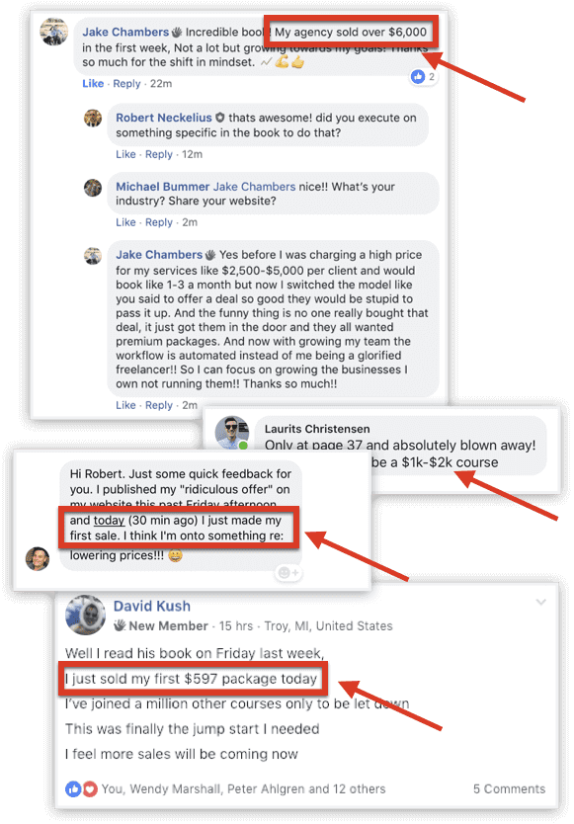
EXAMPLE

Slide 4



EXAMPLE

Slide 5
ASSETS

Slide 6
CREATE YOURS ON THE NEXT SLIDE

Slide 8
To export your image (on the previous slide) click on the slide, then File > Download > PNG image (current slide)

